Slide 1
Nuclear Fuel Performance
NE-533
Spring 2022

Slide 2
Last Time
There are a variety of limiting phenomena in LWR fuel systems that provide the boundaries of operation and lifetime
These limits include phenomena in the fuel, gap, cladding, corrosion, and assembly levels
Primary system water chemistry affects fuel performance through the deposition of corrosion products on fuel pin surfaces
Beginning of mechanistic modeling

Slide 3
MOOSE Project Part 3
0.5 cm
1-D problem, set up in 2D-RZ
Given a uniform heat generation rate of LHR = 175 W/cm, what are the stresses due to thermal expansion in the fuel?
Will need tensor mechanics and heat conduction
1) Assume a constant fuel surface temperature and constant thermal conductivity
2) Assume a constant fuel surface temperature but temperature dependent thermal conductivity
1 cm
Fuel

Slide 4

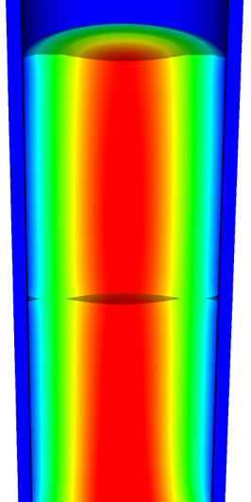
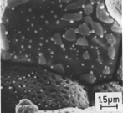
Microstructure-based fuel performance modeling
Structure/property relationships connect the microstructure variables to the property values
Operating Conditions
Neutron flux
Coolant T&P
Variables
Temperature
Displacement
Stoichiometry
Cladding
Property values
Microstructure evolution models
Microstructure evolution models
Fuel Property values
Elasticity tensor
Elasticity tensor
Grain growth
Grain growth
Cladding
Microstructure variables
Average grain size
Dislocation density
H concentration
Hydride fraction
Point defect concentrations
Loop density
2nd phase particle fraction
Fuel
Microstructure variables
Average grain size
Dislocation density
U defect concentrations
Pu concentration
Fission product precipitate fractions
Dissolved fission products
Fission gas bubble fraction
Grain boundary fission gas bubble coverage
Crack parameter
Plasticity
Plasticity
Thermal conductivity
Yield stress
Defect prod. & transport
Defect prod. & transport
Fracture stress
Thermal conductivity
Hydrogen transport
Fission gas behavior
Melting temperature
Failure criteria
Loop evolution
Densification
Diffusion constants
Dimensional change
Gap variable
Gap fission gas concentration
Fracture
Dimensional change

Slide 5

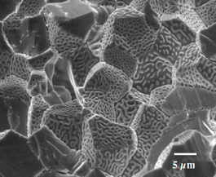
Example: fission gas behavior in the fuel
Take into account a finite set of variables to describe the state of the material
Utilize a mechanistic model of fission gas behavior to predict the evolution of the microstructure
Utilize this updated microstructure to inform a number of structure/property relationships
Variables
Temperature
Displacement
Stoichiometry
Elasticity tensor
Thermal conductivity
Model of fission gas behavior
Structure/property relationships
Fracture stress
Dissolved fission products
Fission gas bubble fraction
Grain boundary fission gas bubble coverage
Gap fission gas concentration
Dimensional change
Gap conductance
Gap pressure

Slide 6
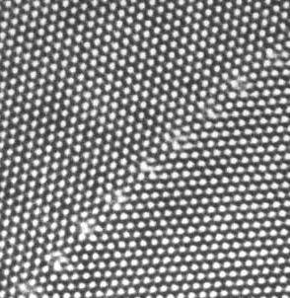
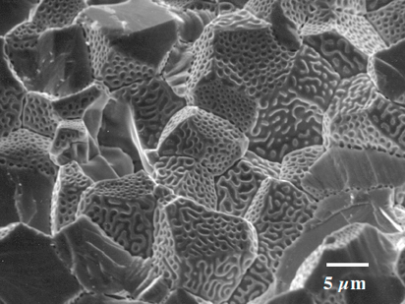
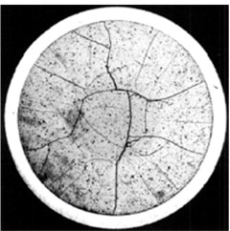
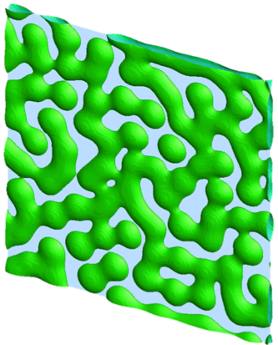
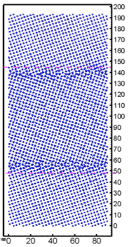
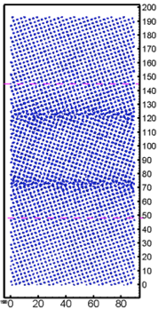
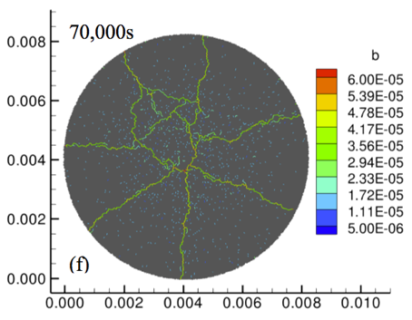
Multiscale separate effects experiments and simulations inform the development of the models
nm
μm
mm

Slide 7
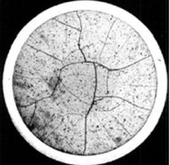
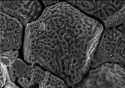
Microstructure-based models
Can provide a structure/property relationship to replace the existing burnup dependent model
For example, thermal conductivity, taking into account microstructural features and their evolution
Grain boundary and bubbles
Intragranular porosity
Precipitated fission products
κ_{pr}
Bulk conductivity
Vacancies and interstitials
Fission gas

Slide 8
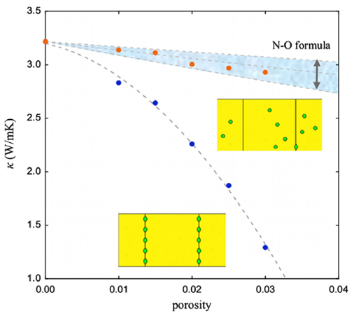
Parametrizing the mechanistic model
We employ multiscale modeling and simulation to determine the various parameters for the model
MD simulations conducted at LANL have been used to determine the coefficients for various point defects
MD simulations have shown that phonon scattering must be accounted for to accurately represent small bubbles
Mesoscale simulations have shown that GrB bubbles have a larger impact on the thermal conductivity
Maxwell-Eucken (no phonon scattering)

Slide 9
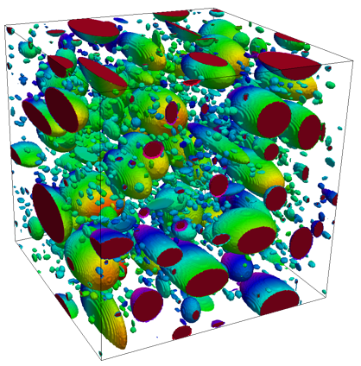
Parametrizing the mechanistic model
A thermal resistor model is created to describe the impact of GB bubbles on the thermal conductivity
MARMOT simulations are currently being used to inform the development of the precipitate multiplier

Slide 10
Parametrizing the mechanistic model
Each term in the expression must be coupled to a corresponding state variable
The full model calculates the thermal conductivity as a function of:
Temperature
Point defect concentrations
Intragranular bubble density and average radius
Fractional coverage of bubbles on GBs and average radius
Precipitate volume fractions and average sizes
Currently effects of precipitate fission products and individual point defects are neglected in the model, as they are not tracked or predicted in BISON

Slide 11
Comparing with experiments…
The model under-predicts the temperature in most cases, but not all
Thus, the model is neglecting some resistive effects from the microstructure
Generally performs as well, and in some cases better, than the burnup based model
RISO-3 AN3
RISO-3 AN4
RISO II-3
US PWR TSQ0002

Slide 12
UZr Fuel Performance Modeling
Development of a quantitative phase-field model of macroscale constituent redistribution in the U-Zr system, where model parameters were optimized, and the model validated against an independent data set
Calculation of surface tension based on molecular dynamics, which is used in the BISON gaseous metallic fuel swelling model

Slide 13
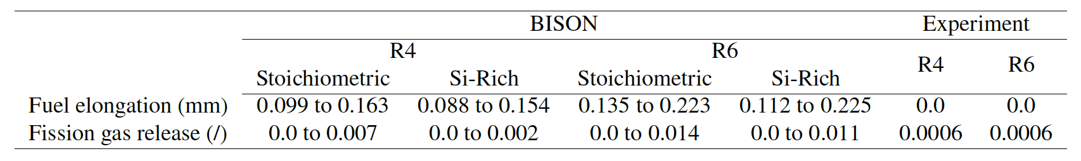
U3Si2 Fuel Performance Modeling
Point Defect Diffusion, Fission gas swelling, thermal and irradiation creep

Slide 14
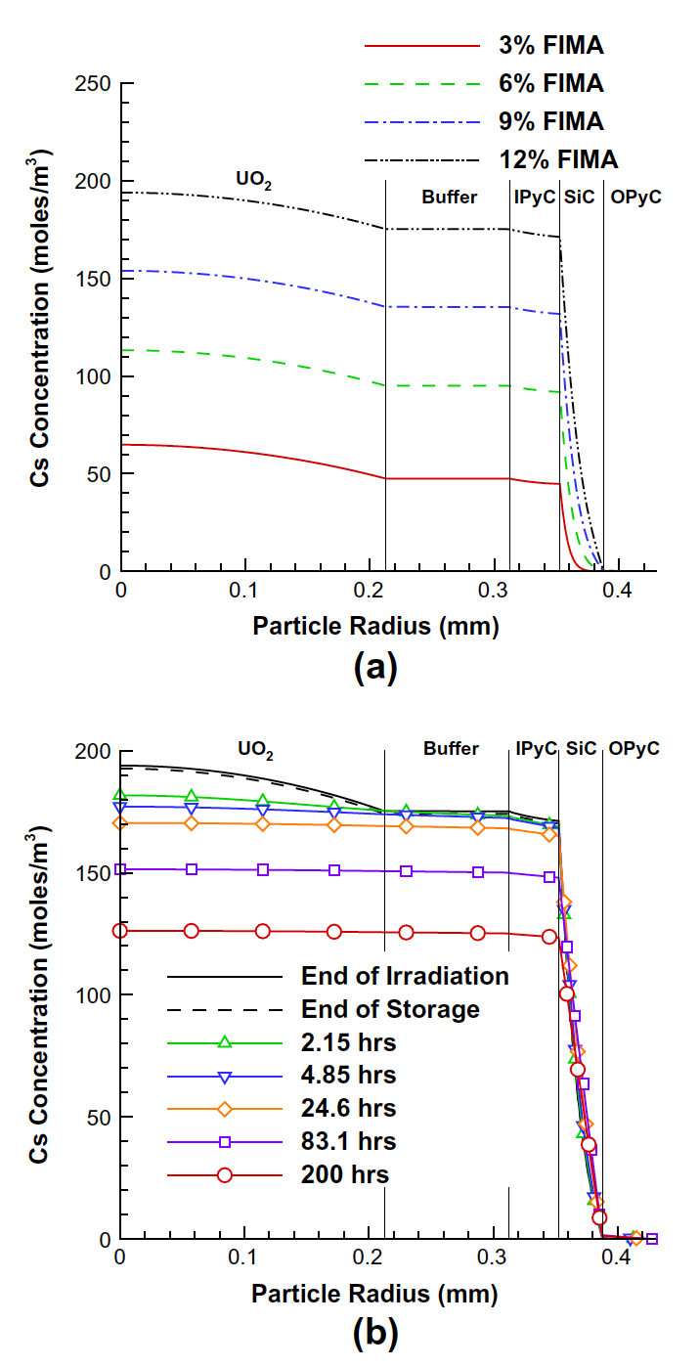
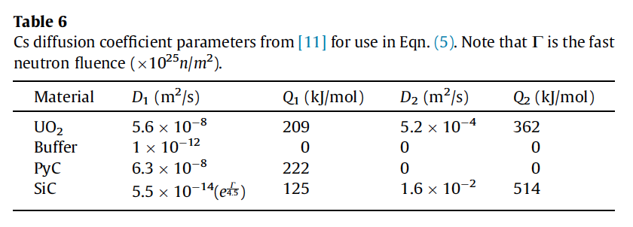
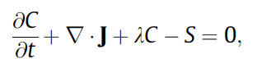
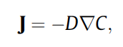
TRISO Particle Fuel Performance Modeling
TRISO particle modeling is still under development from a mechanistic model standpoint
Imperfect data for many critical fission products through different layers
Data typically for UO2 only, not for UC or UCO fuel kernels

Slide 15
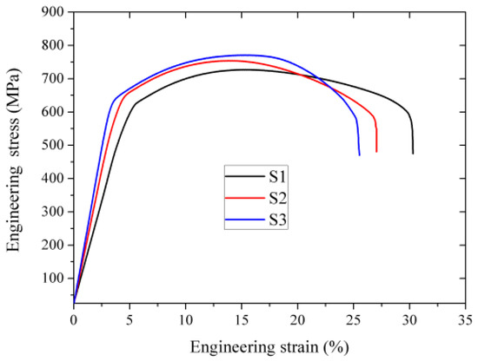
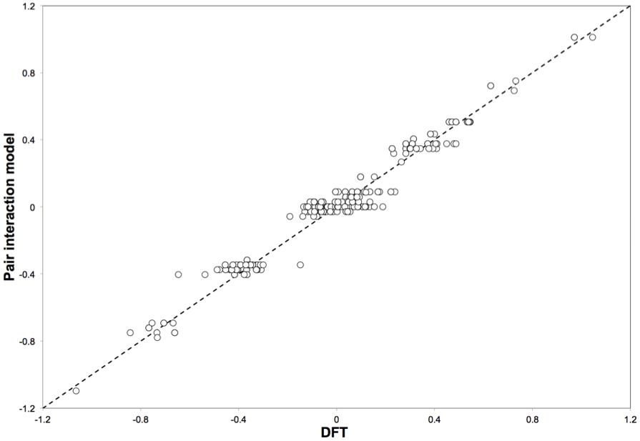
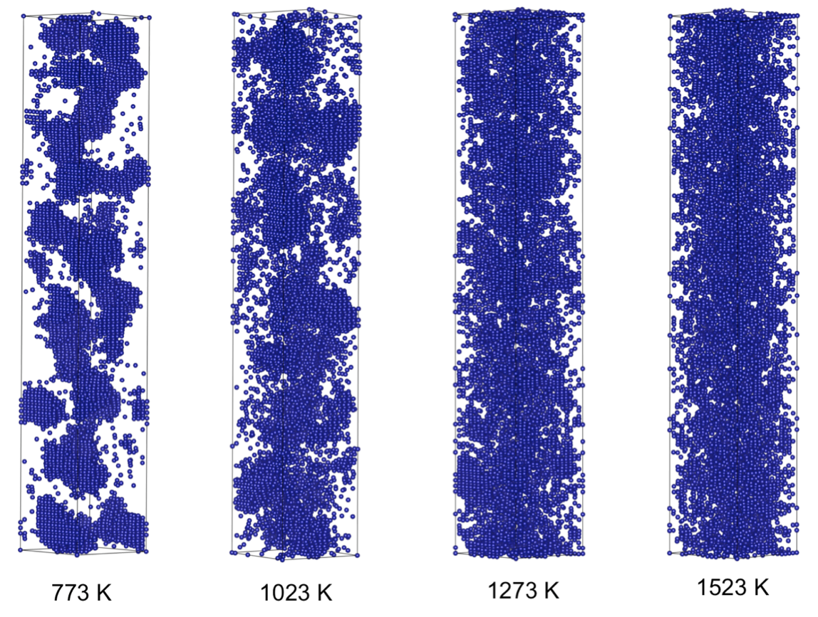
FeCrAl
Evolution of compositional randomness (precipitation) will affect the mechanical properties of FeCrAl
Kinetic Monte Carlo simulations modeled the precipitation of alpha’ phase from bcc Fe-Cr alloys under thermal aging at various temperatures
Fe-Al alloys do not show any phase separation
Can determine critical temperatures for precipitation and the resulting microstructures to investigate potential hardening

Slide 16
Summary
Researchers are working to develop materials models for the fuel and cladding that are mechanistic rather than empirical and that are based on the evolution of the microstructure rather than the burnup.

Slide 17
Mixed oxide (MOX) fuels

Slide 18
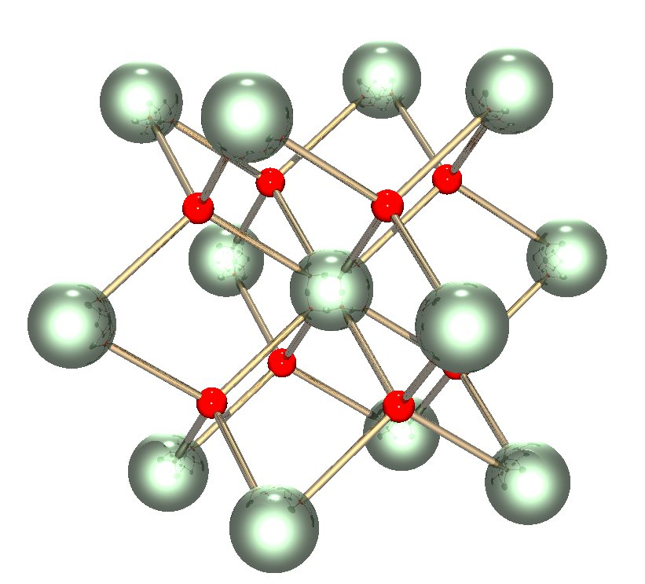
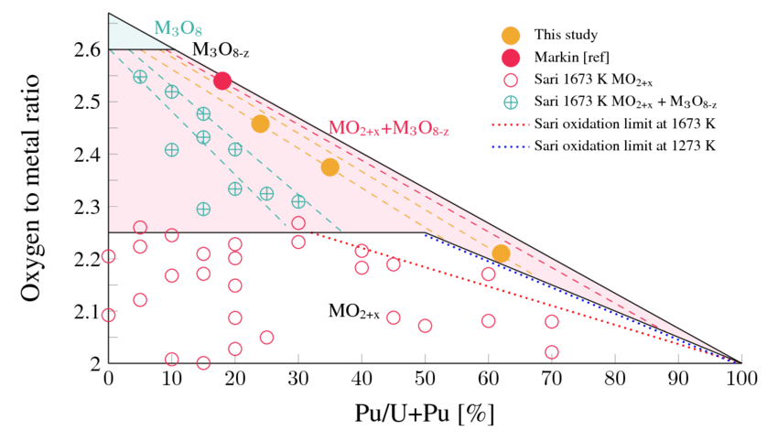
Why MOX?
The first fast breeder reactors built in the 1950s used metallic fuel (plutonium and uranium), as metals offer the highest heavy metal density and therefore the highest breeding ratio
Because of dimensional instability due to swelling and growth, metal fuels could hardly achieve high burnup
By the 1960s, mixed uranium and plutonium oxide (U,Pu)O2 was known to be highly radiation tolerant and began to be considered as a reference fuel for fast reactors

Slide 19
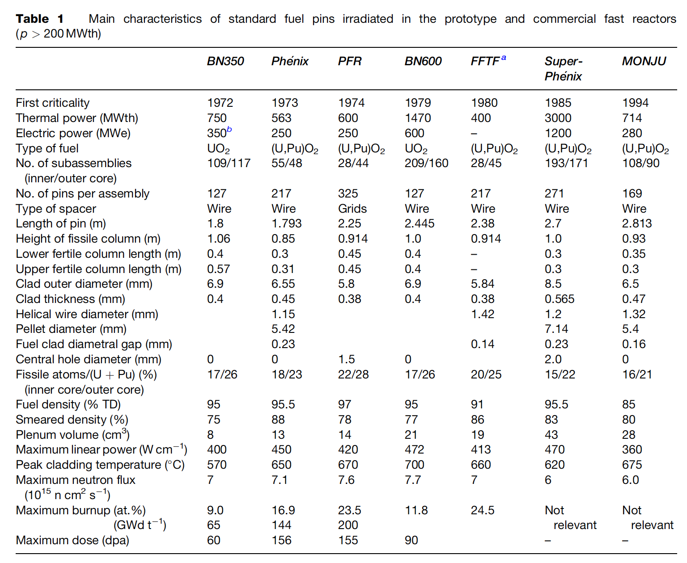
Mixed Oxides
UO2 can be combined with PuO2 for a mixed oxide (MOX) fuel for use in fast reactors
Allows to burn excess weapons grade plutonium
About 30 reactors in Europe currently utilize a partial MOX core
Similar behavior to UO2, but different neutronics, fission gas release, thermal conductivity, etc.
Less common is inclusion of minor actinides in MOX to burn waste

Slide 20
MOX Designs
The fuel pin is a long cylinder (2–3m long, 5–10mm diameter), clad in a steel tube (0.4–0.6mm thick) closed in both ends by welded plugs, preventing direct contact between the radioactive material and the sodium coolant
The oxide fissile column (~1 m long) consists of a stack of conventionally pressed and sintered pellets with an outer diameter slightly smaller than the inner diameter of the clad, providing a gap ~100 micron gap
Both full pellets and annular pellets have been used
A He gap with a pressure ~1 atm is used
Fuel pins of fast reactors are designed to operate at a high linear heat generation rate: between 400 and 500 W/cm, about twice higher than standard linear power in light water reactors (LWRs)

Slide 21
MOX Fuel
As the fast reactor fuel pin diameters are generally smaller than classical rod diameters of LWRs, the power density and heat fluxes are much higher in fast reactors than in LWRs
For example, in a Phenix fuel pin at 450W/cm, the power density in the pellet reaches almost 2000 W/cc
Sodium enters the bottom part of the core at about 400 C and the average coolant temperature above the core is typically about 550 C
The neutron flux is very intense (~7x10¹⁵ n/cm²/s in the core center) and the assembly materials suffer high damage, more than 100 dpa, at high burnup
Qualifying metallic materials able to withstand such high damage while keeping their shape and mechanical properties was/is one of the key challenges for fast reactors
In order to reduce fuel cycle costs, the main objective of oxide fuels R&D for fast reactors has been to reach high burnup, typically around 150 GWd/ton, about twice the burnup achieved in LWRs

Slide 22
MOX Fuel
The main requirements and design criteria are the following:
Guaranteeing the absence of fuel melting, both in nominal conditions and during off-normal events
Keeping cladding integrity and fuel pin tightness
Cooling of the fuel pin bundle must be ensured up to high burnup in all operating conditions
Loading and unloading of subassemblies have to be guaranteed, which induces a limitation on the deformation of the hexagonal wrapper tubes

Slide 23
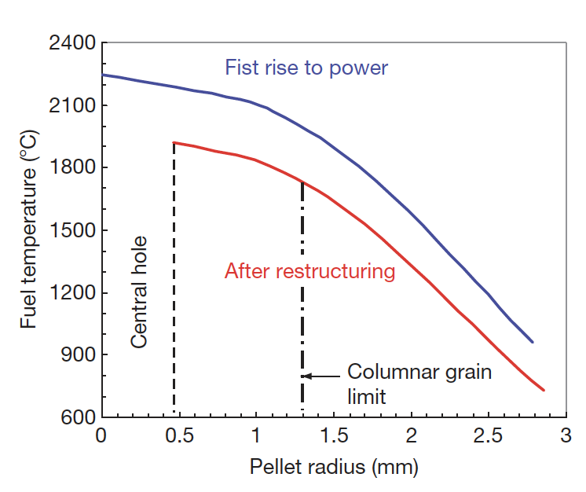
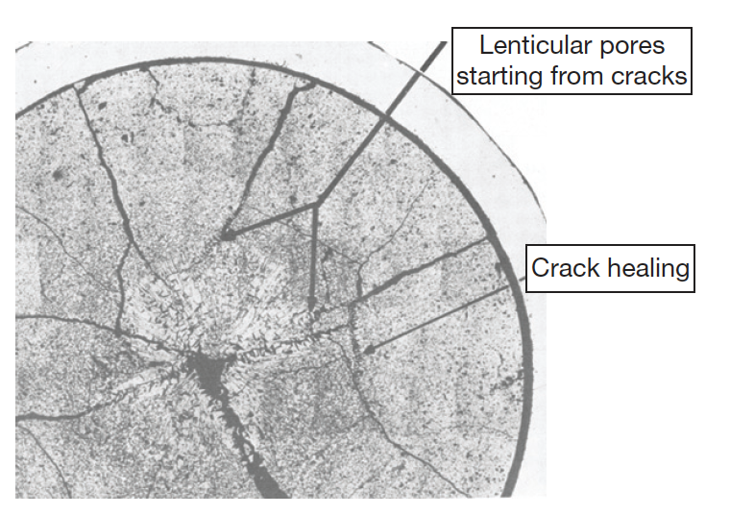
MOX Fuels
Most phenomena occurring inside oxide fuel pellets are thermally activated, and a good knowledge of the thermal field inside the fuel stack is key
Centerline temperatures can reach above 2000C, significantly higher than thermal LWRs
Thermal conductivity is low and degrades with irradiation
Due to the steep thermal gradient, thermal stress cracks form
Restructuring takes place due to the high temperatures, leading to distinct regions in the fuel

Slide 24
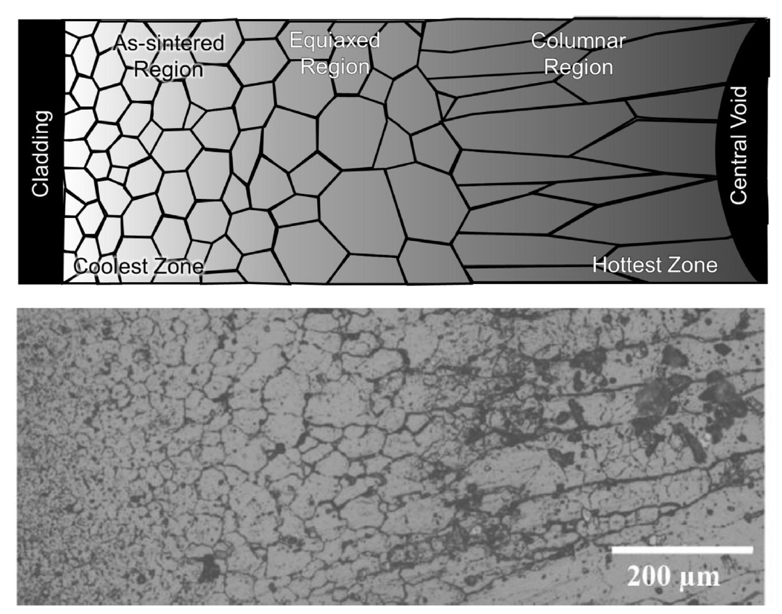
MOX Restructuring
Pu bearing fast reactor oxide fuels display four defining regions of a restructured pellet:
the central void, the columnar grain growth region, the equiaxed grain growth region, and the as-sintered region
The higher temperatures and heating rates form coarse, elongated grains that grow radially toward the outer rim of the fuel
The equiaxed region consists of grains that have undergone significant growth when compared to the un-irradiated samples
The central void forms from the accumulation of voids and pores present in the fuel along a thermal gradient

Slide 25
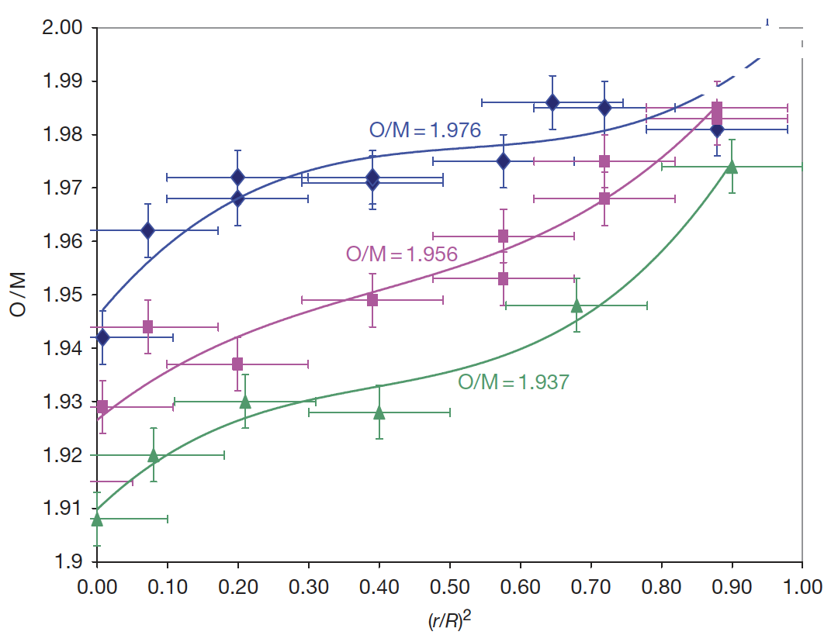
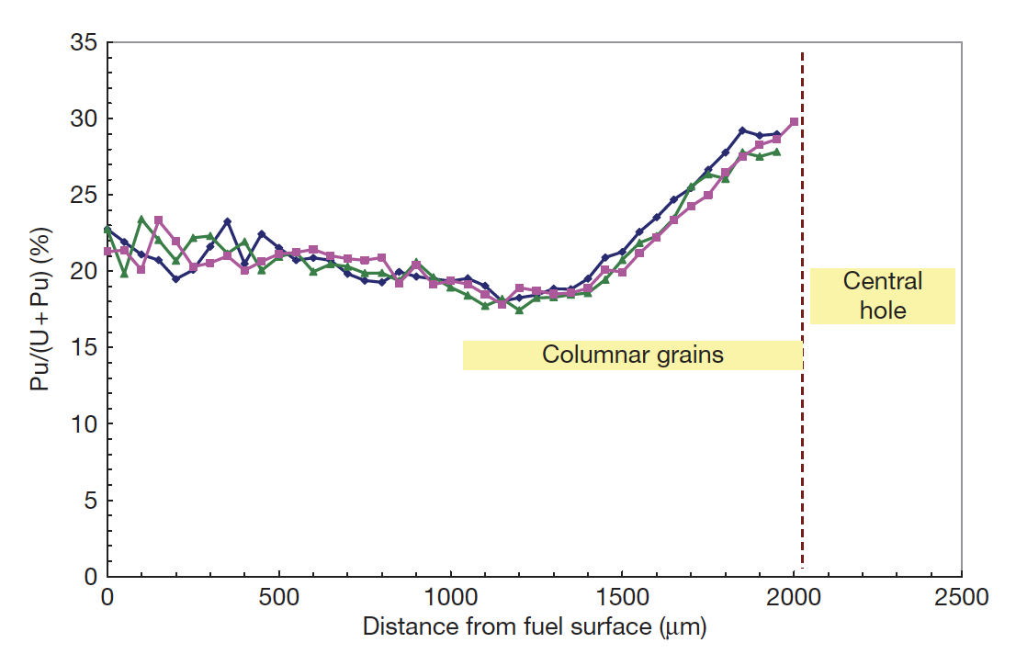
Constituent Redistribution
The as-fabricated oxide pellets to be used as fuel in fast reactors are always hypostoichiometric with an initial O/M typically in the range 1.93–2.00
Oxygen is redistributed radially, migrating down the thermal gradient, thus bringing the composition close to stoichiometry near the periphery, whereas the O/M ratio becomes very low in the hottest area
Irradiated oxide pellets generally exhibit a plutonium enrichment in the central area near the central hole, and a slight plutonium depletion in a ring located near the periphery of columnar grains

Slide 26
Gap Closure
Although the thermal expansion coefficient is lower in oxide fuel than in austenitic stainless steel cladding the temperatures in the fuel pellets are much higher than in the cladding and induce a higher thermal expansion in the fuel pellet
At high linear powers gap closure is completed after a burnup of about 1% or even less
Fuel pellets are broken into several fragments at the end of first rise to power, resulting in a small average displacement of matter toward the cladding
The force exerted on the fuel column by the spring located in the upper part of causes an axial compression creep
The main cause of gap closure is probably the gaseous swelling of the fuel

Slide 27
Fission Products
The main objective of oxide fuels in fast reactors is to achieve very high burnup; 15 at.% or even more is typically considered as a reference target
This means that at the end of irradiation, 15% of the initial actinide atoms (U and Pu) have disappeared and 30% new atoms are present in the fuel
All physical and chemical properties of oxide fuel will continuously evolve during its lifetime in the reactor; in particular, fission products will induce a decrease of thermal conductivity as well as a decrease of melting point, thus reducing the margin to fuel melting
Most phenomena occurring in the fuel pins will be a direct consequence of these fission products
This large amount of fission products is one of the specificities of fast oxide fuel
The fission products effects depend upon the chemical state of the fission product, which is influenced by the oxygen potential of the fuel

Slide 28
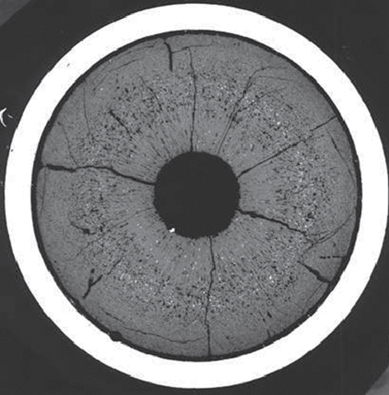
Fission Products
Fission products lie in the main five families:
solid solution, oxide precipitates, metallic precipitates, volatile gases, noble gases
On the metallographs of fuel irradiated at high burnup, white inclusions are systematically observed
The higher the burnup and the temperature, the larger these precipitates
In most cases, EPMA on these precipitates shows essentially five elements: Mo, Ru, Tc, Rh, and Pd.
They are the five ‘noble metal’ fission products with the highest yield

Slide 29
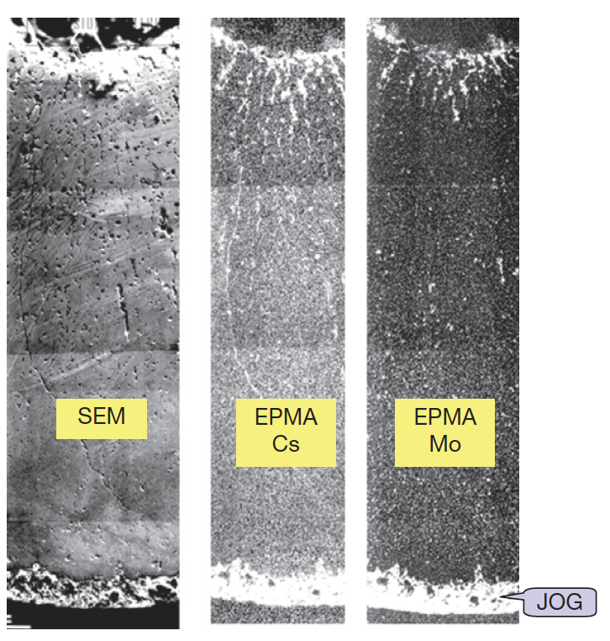
Joint Oxide Gain (JOG)
Even after gap closure, there remains a residual gap a couple of micrometers wide due to surface roughness
At high burnup, radial micrographs show a reopening of the gap, however, this gap is no longer filled with gas, but with fission product compounds
All the fission products migrating toward the cold region of the pellet accumulate first in the oxide fuel, and then escape the fuel and accumulate between the fuel and the cladding where they form a bonding layer
At high burnup, this JOG reaches a diameter width of about 150 μm
Serves as mechanical buffer; has low thermal cond.

Slide 30
FCCI
FCCI appears as one of the potential life-limiting factors for high burnup fuel elements
Fission products in the JOG play a predominant role on FCCI and on the resulting strong corrosion
The (U,Pu)O2 fuel itself does not directly react with the cladding, but it provides the oxygen needed for some of the reactions
Volatile fission products, tellurium and cesium, are the corrosive species able to overcome the passivation of stainless steel and therefore to induce clad corrosion
Several types of corrosion reactions and mechanisms are possible, occurring at different stages of irradiation, sometimes successively in the same pin, and resulting in different attack features
Thus, a qualitative understanding of corrosion mechanisms has been achieved, but it is not yet possible to give a complete physical description of FCCI and to predict corrosion depths

Slide 31
Summary
Oxide fuel for fast reactors has proved to be a mature, quite reliable, and very robust fuel concept
SFRs with MOX operate at much higher power and temperature than LWRs
Despite the low thermal conductivity, fuel loadings to the cladding remain low, and oxide fuel pins have demonstrated an ability to reach extremely high burnup (>15 at%)
O/M ratio is one of the most significant factors in determining the nature of actinide redistribution, fission product precipitate chemistries, and FCCI formation

